Slide 1


http://www.comp.nus.edu.sg/~cs2100/
CS2100 Recitation 9
MSI Components
24 March 2025
Aaron Tan

Slide 2
Contents
Decoders
Implementing functions using decoders
Decoder with enable
Standard MSI decoder
Encoders
Priority encoders
Multiplexers
Standard MSI multiplexer
Implementing functions using multiplexers
Using smaller multiplexers
Selected Past Years’ Exam Questions
AY2016/17 Sem2 Q2
AY2017/18 Sem2 Q3(a)(b)(c)
AY2018/19 Sem2 Q5(c)
AY2019/20 Sem2 Q5(a)(b)

Slide 3
summary
Decoders
decoder
code
entity

Slide 4



Decoding – the inefficient way
0
0
0
0
0
1
0
0
0
1
2
3
4
5
6
7

Slide 5
Decoding – the better way
1
0
1
Some device
0
1
2
3
4
5
6
7

Slide 6
2. Decoders (2/5)
Example: If codes 00, 01, 10, 11 are used to identify four persons, we may use a 2-bit decoder.
2x4
DEC
F₀ F₁ F₂ F₃
Person 0
Person 1
Person 2
Person 3
2-bit code
X
Y
This is a 2×4 decoder which selects an output line based on the 2-bit code supplied.
Truth table:
X | Y | F₀ | F₁ | F₂ | F₃
0 | 0 | 1 | 0 | 0 | 0
0 | 1 | 0 | 1 | 0 | 0
1 | 0 | 0 | 0 | 1 | 0
1 | 1 | 0 | 0 | 0 | 1

Slide 7
2. Decoders (3/5)
X | Y | F₀ | F₁ | F₂ | F₃
0 | 0 | 1 | 0 | 0 | 0
0 | 1 | 0 | 1 | 0 | 0
1 | 0 | 0 | 0 | 1 | 0
1 | 1 | 0 | 0 | 0 | 1
From truth table, circuit for 2×4 decoder is:
F₀ = X'⋅Y'
F₁ = X'⋅Y
Each output is a minterm (X'⋅Y', X'⋅Y, X⋅Y' or X⋅Y) of a 2-variable function.
F₂ = X⋅Y'
F₃ = X⋅Y
X
Y

Slide 8
2. Decoders (4/5)
Design a 3×8 decoder.
F₀ = x'⋅y'⋅z'
x | y | z | F₀ | F₁ | F₂ | F₃ | F₄ | F₅ | F₆ | F₇
0 | 0 | 0 | 1 | 0 | 0 | 0 | 0 | 0 | 0 | 0
0 | 0 | 1 | 0 | 1 | 0 | 0 | 0 | 0 | 0 | 0
0 | 1 | 0 | 0 | 0 | 1 | 0 | 0 | 0 | 0 | 0
0 | 1 | 1 | 0 | 0 | 0 | 1 | 0 | 0 | 0 | 0
1 | 0 | 0 | 0 | 0 | 0 | 0 | 1 | 0 | 0 | 0
1 | 0 | 1 | 0 | 0 | 0 | 0 | 0 | 1 | 0 | 0
1 | 1 | 0 | 0 | 0 | 0 | 0 | 0 | 0 | 1 | 0
1 | 1 | 1 | 0 | 0 | 0 | 0 | 0 | 0 | 0 | 1
F₁ = x'⋅y'⋅z
F₂ = x'⋅y⋅z'
F₃ = x'⋅y⋅z
F₄ = x⋅y'⋅z'
F₅ = x⋅y'⋅z
F₆ = x⋅y⋅z'
F₇ = x⋅y⋅z
Each output is a minterm of a 3-variable function.
x
y
z

Slide 9
2. Decoders: Implementing Functions (1/3)
A Boolean function, in sum-of-minterms form a
decoder to generate the minterms, and
an OR gate to form the sum.
Any combinational circuit with n inputs and m outputs can be implemented with an n:2^{n} decoder with m OR gates.
Good when circuit has many outputs, and each function is expressed with a few minterms.

Slide 10
2. Decoders: Implementing Functions (2/3)
Example: Full adder
S(x, y, z) = Σ m(1,2,4,7)
C(x, y, z) = Σ m(3,5,6,7)
3x8
DEC
0
1
2
3
4
5
6
7
S
x
S₂
S₁
S₀
y
z
C

Slide 11
2. Decoders: Implementing Functions (3/3)
S(x, y, z) = Σ m(1,2,4,7)
C(x, y, z) = Σ m(3,5,6,7)
3x8
DEC
1
0
0
0
0
0
0
0
0
1
0
0
0
0
0
0
0
1
2
3
4
5
6
7
0
0
0
0
0
0
0
1
0
1
S
1
0
0
1
x
0
0
0
1
1
1
S₂
S₁
S₀
y
0
0
C
1
z
BRAVO!!!


Slide 12
2. Decoders with Enable (1/2)
Decoders often come with an enable control signal, so that the device is only activated when the enable, E = 1.
Truth table:
F₀ = E⋅X'⋅Y'
E | X | Y | F₀ | F₁ | F₂ | F₃
1 | 0 | 0 | 1 | 0 | 0 | 0
1 | 0 | 1 | 0 | 1 | 0 | 0
1 | 1 | 0 | 0 | 0 | 1 | 0
1 | 1 | 1 | 0 | 0 | 0 | 1
0 | d | d | 0 | 0 | 0 | 0
F₁ = E⋅X'⋅Y
F₂ = E⋅X⋅Y'
F₃ = E⋅X⋅Y
Circuit of a 2×4 decoder with enable:
X
Y
E

Slide 13
2. Decoders with Enable (2/2)
In the previous slide, the decoder has a one-enable control signal, i.e. the decoder is enabled with E=1.
In most MSI decoders, enable signal is zero-enable, usually denoted by E' or Ē. The decoder is enabled when the signal is zero (low).
E | X | Y | F₀ | F₁ | F₂ | F₃
1 | 0 | 0 | 1 | 0 | 0 | 0
1 | 0 | 1 | 0 | 1 | 0 | 0
1 | 1 | 0 | 0 | 0 | 1 | 0
1 | 1 | 1 | 0 | 0 | 0 | 1
0 | d | d | 0 | 0 | 0 | 0
E' | X | Y | F₀ | F₁ | F₂ | F₃
0 | 0 | 0 | 1 | 0 | 0 | 0
0 | 0 | 1 | 0 | 1 | 0 | 0
0 | 1 | 0 | 0 | 0 | 1 | 0
0 | 1 | 1 | 0 | 0 | 0 | 1
1 | d | d | 0 | 0 | 0 | 0
Decoder with 1-enable
Decoder with 0-enable

Slide 14
2. Constructing Larger Decoders (1/4)
Larger decoders can be constructed from smaller ones.
Example: A 3×8 decoder can be built from two 2×4 decoders (with one-enable) and an inverter.
3x8
DEC
F₀ = w'⋅x'⋅y'
F₁ = w'⋅x'⋅y
:
:
F₇ = w⋅x⋅y
0
1
:
:
7
w
x
y
S₂
S₁
S₀
2x4
DEC
w
x
y
0
1
2
3
F₀ = w'⋅x'⋅y'
F₁ = w'⋅x'⋅y
F₂ = w'⋅x⋅y'
F₃ = w'⋅x⋅y
S₁
S₀
E
2x4
DEC
0
1
2
3
F₄ = w⋅x'⋅y'
F₅ = w⋅x'⋅y
F₆ = w⋅x⋅y'
F₇ = w⋅x⋅y
S₁
S₀
E

Slide 15
2. Constructing Larger Decoders (2/4)
3x8
Dec
F₀ = w'⋅x'⋅y'
F₁ = w'⋅x'⋅y
:
:
F₇ = w⋅x⋅y
0
1
:
:
7
w
x
y
S₂
S₁
S₀
BRAVO!!!
0
0
0
0
0
1
1
1
0
2x4
Dec
1
0
0
0
0
1
0
0
0
0
0
0
w
x
y
0
1
2
3
F₀ = w'⋅x'⋅y'
F₁ = w'⋅x'⋅y
F₂ = w'⋅x⋅y'
F₃ = w'⋅x⋅y
S₁
S₀
E
1
1
0
2x4
Dec
0
0
0
0
0
0
0
0
0
0
1
0
0
1
2
3
F₄ = w⋅x'⋅y'
F₅ = w⋅x'⋅y
F₆ = w⋅x⋅y'
F₇ = w⋅x⋅y
S₁
S₀
E
0
0
1


Slide 16
2. Constructing Larger Decoders (3/4)
Construct a 4×16 decoder from two 3×8 decoders with one-enable and an inverter.
4x16
DEC
w
x
y
z
S₃
S₂
S₁
S₀
0
1
:
:
15
F₀
F₁
:
:
F₁₅
3x8
DEC
w
x
y
z
0
1
:
7
F₀
F₁
:
F₇
S₂
S₁
S₀
E
3x8
DEC
S₂
S₁
S₀
0
1
:
7
F₈
F₉
:
F₁₅
E
Note: The input w and its complement w' are used to select either one of the two smaller decoders.

Slide 17

Exercise: How to construct a 4×16 decoder using five 2×4 decoders with enable?
2x4
Dec
0
1
2
3
F₀ = (w'⋅x')⋅y'⋅z'
F₁ = (w'⋅x')⋅y'⋅z
F₂ = (w'⋅x')⋅y⋅z'
F₃ = (w'⋅x')⋅y⋅z
y
z
S₁
S₀
E
2x4
Dec
0
1
2
3
w
x
S₁
S₀
2x4
Dec
0
1
2
3
F₄ = (w'⋅x)⋅y'⋅z'
F₅ = (w'⋅x)⋅y'⋅z
F₆ = (w'⋅x)⋅y⋅z'
F₇ = (w'⋅x)⋅y⋅z
E
y
z
S₁
S₀
1
E
2x4
Dec
0
1
2
3
F₈ = (w⋅x')⋅y'⋅z'
F₉ = (w⋅x')⋅y'⋅z
F₁₀ = (w⋅x')⋅y⋅z'
F₁₁ = (w⋅x')⋅y⋅z
y
z
S₁
S₀
E
2x4
Dec
0
1
2
3
F₁₂ = (w⋅x)⋅y'⋅z'
F₁₃ = (w⋅x)⋅y'⋅z
F₁₄ = (w⋅x)⋅y⋅z'
F₁₅ = (w⋅x)⋅y⋅z
y
z
S₁
S₀
E

Slide 18
Negated outputs (active low outputs) decoders
A decoder may be 1-enabled or 0-enabled.
A decoder may also normal output or negated outputs. (See next two slides.)
Normal outputs = active high outputs
Negated outputs = active low outputs
E | X | Y | F₀ | F₁ | F₂ | F₃
1 | 0 | 0 | 1 | 0 | 0 | 0
1 | 0 | 1 | 0 | 1 | 0 | 0
1 | 1 | 0 | 0 | 0 | 1 | 0
1 | 1 | 1 | 0 | 0 | 0 | 1
0 | d | d | 0 | 0 | 0 | 0
E | X | Y | F₀ | F₁ | F₂ | F₃
1 | 0 | 0 | 0 | 1 | 1 | 1
1 | 0 | 1 | 1 | 0 | 1 | 1
1 | 1 | 0 | 1 | 1 | 0 | 1
1 | 1 | 1 | 1 | 1 | 1 | 0
0 | d | d | 1 | 1 | 1 | 1
1-enabled, active high outputs 2x4 decoder.
1-enabled, active low outputs 2x4 decoder.

Slide 19
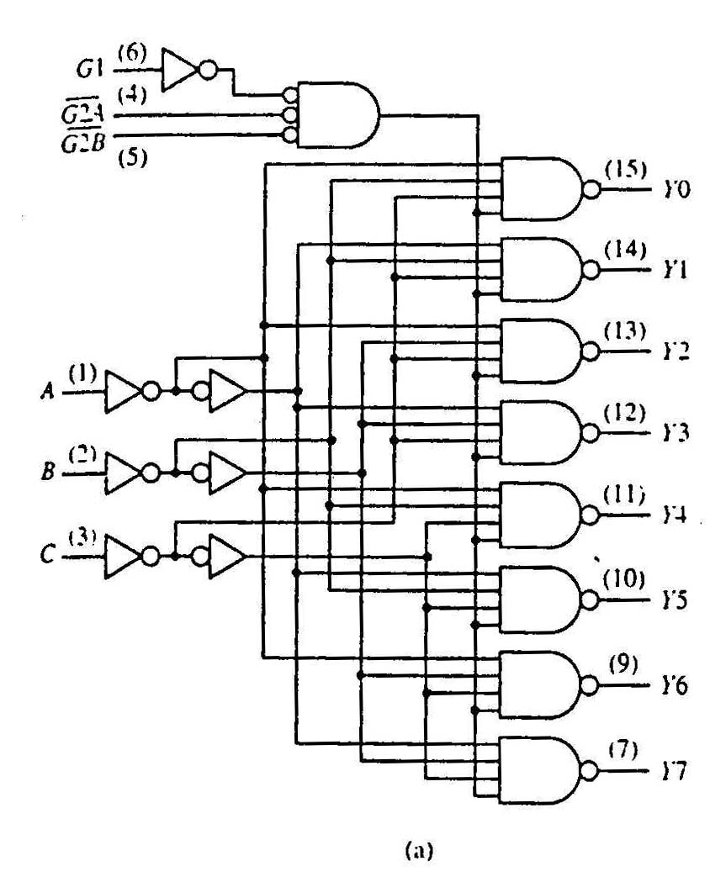
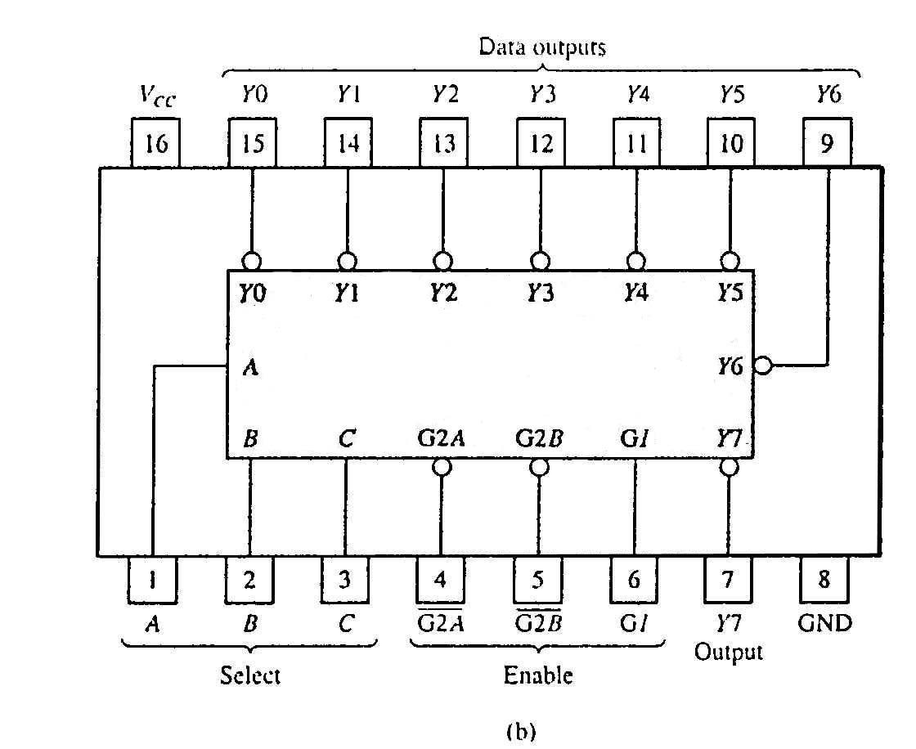
2. Standard MSI Decoder (1/2)
74138 (3-to-8 decoder)
74138 decoder module.
(a) Logic circuit.
(b) Package pin configuration.

Slide 20
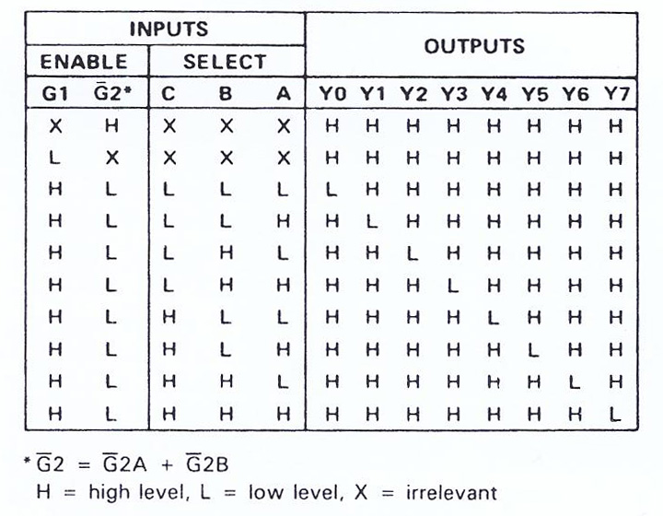
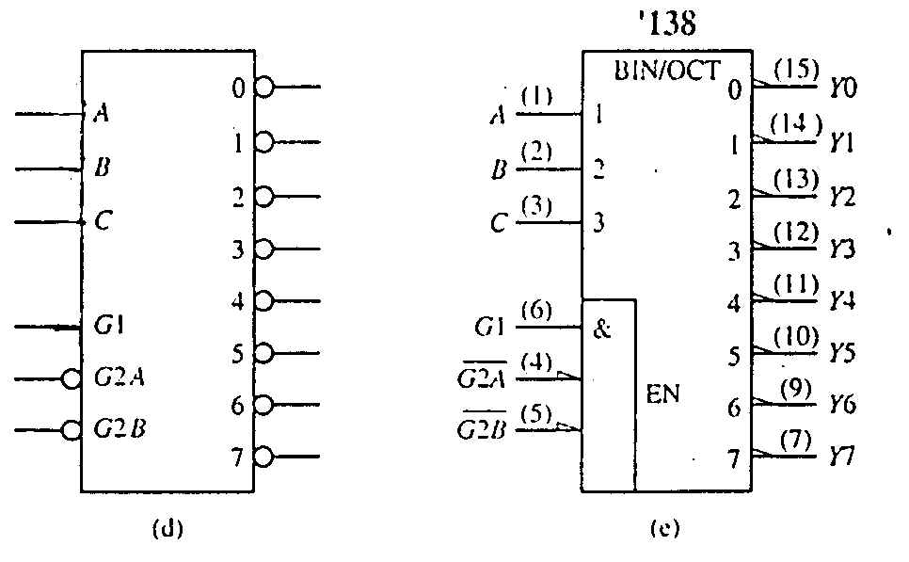
2. Standard MSI Decoder (2/2)
74138 decoder module.
(c) Function table.
(c)
74138 decoder module.
(d) Generic symbol.
(e) IEEE standard logic symbol.
Source:The Data Book Volume 2, Texas Instruments Inc.,1985

Slide 21
2. Decoders: Implementing Functions Revisit (1/2)
Example: Implement the following function using a 3×8 decoder and an appropriate logic gate
f(Q,X,P) = ∑ m(0,1,4,6,7) = ∏ M(2,3,5)
We may implement the function in several ways:
Using a decoder with active-high outputs with an OR gate: f(Q,X,P) = m₀ + m₁ + m₄ + m₆ + m₇
Using a decoder with active-low outputs with a NAND gate: f(Q,X,P) = (m₀' ⋅ m₁' ⋅ m₄' ⋅ m₆' ⋅ m₇' )'
Using a decoder with active-high outputs with a NOR gate: f(Q,X,P) = (m₂ + m₃ + m₅ )' [ = M₂ ⋅ M₃ ⋅ M₅ ]
Using a decoder with active-low outputs with an AND gate: f(Q,X,P) = m₂' ⋅ m₃' ⋅ m₅'

Slide 22
2. Decoders: Implementing Functions Revisit (2/2)
f(Q,X,P) = Σm(0,1,4,6,7) = ∏ M(2,3,5)
0
1
2
3
4
5
6
7
0
1
2
3
4
5
6
7
3x8
Dec
3x8
Dec
Q
X
P
A
B
C
f(Q,X,P)
Q
X
P
A
B
C
f(Q,X,P)
(m0'·m1'·m4'·m6'·m7)'
=m0+m1+m4+m6+m7
(a) Active-high decoder with OR gate.
(b) Active-low decoder with NAND gate.
0
1
2
3
4
5
6
7
0
1
2
3
4
5
6
7
3x8
Dec
3x8
Dec
f(Q,X,P)
f(Q,X,P)
Q
X
P
A
B
C
Q
X
P
A
B
C
(m2+m3+m5)'
= m2'·m3'·m5'
= M2·M3·M5
m2'·m3'·m5'
= M2·M3·M5
(c) Active-high decoder with NOR gate.
(d) Active-low decoder with AND gate.

Slide 23
summary
Encoders
encoder
entity
code

Slide 24
3. Encoders (1/4)
Encoding is the converse of decoding.
Given a set of input lines, of which exactly one is high and the rest are low, the encoder provides a code that corresponds to that high input line.
Contains 2^{n} (or fewer) input lines and n output lines.
Implemented with OR gates.
Example:
F₀
D₀
Select via switches
F₁
4-to-2 Encoder
F₂
2-bits code
F₃
D₁

Slide 25


Encoding – the inefficient way
0
1
2
3
4
5
6
7
0
0
0
0
0
1
0
0

Slide 26
Encoding – the better way
0
1
2
3
4
5
6
7
Some device
1
0
1

Slide 27
3. Encoders (2/4)
F₂
D₁
Truth table:
X | 1 | X | 1
0 | X | X | X
X | X | X | X
0 | X | X | X
With K-map, we obtain:
D₁ = F₂ + F₃
D₀ = F₁ + F₃
F₁
F₀
F₃
Circuit:
F₂
D₀
F₀
X | 1 | X | 0
1 | X | X | X
X | X | X | X
0 | X | X | X
F₁
D₀
F₁
F₂
F₀
F₃
D₁
F₃
Simple 4-to-2 encoder


Slide 28
3. Encoders (3/4)
Example: 8-to-3 encoder.
At any one time, only one input line of an encoder has a value of 1 (high), the rest are zeroes (low).

Slide 29
3. Encoders (4/4)
Example: 8-to-3 encoder.
D₀
D₁
D₂
D₃
D₄
D₅
D₆
D₇
x = D₄ + D₅ + D₆ + D₇
y = D₂ + D₃ + D₆ + D₇
z = D₁ + D₃ + D₅ + D₇
An 8-to-3 encoder
Exercise: Can you design a 2^{n}-to-n encoder without using K-map?

Slide 30
3. Priority Encoders (1/2)
A priority encoder is one with priority
To allow for more than one input line to carry a 1.
If two or more inputs or equal to 1, the input with the highest priority takes precedence.
If all inputs are 0, this input combination is considered invalid.
Example of a 4-to-2 priority encoder:
Inputs |  |  |  | Outputs
D₀ | D₁ | D₂ | D₃ | f | g | V
0 | 0 | 0 | 0 | X | X | 0
1 | 0 | 0 | 0 | 0 | 0 | 1
X | 1 | 0 | 0 | 0 | 1 | 1
X | X | 1 | 0 | 1 | 0 | 1
X | X | X | 1 | 1 | 1 | 1

Slide 31
3. Priority Encoders (2/2)
Understanding “compact” function table
Inputs |  |  |  | Outputs
D₀ | D₁ | D₂ | D₃ | f | g | V
0 | 0 | 0 | 0 | X | X | 0
1 | 0 | 0 | 0 | 0 | 0 | 1
X | 1 | 0 | 0 | 0 | 1 | 1
X | X | 1 | 0 | 1 | 0 | 1
X | X | X | 1 | 1 | 1 | 1
Inputs |  |  |  | Outputs
D₀ | D₁ | D₂ | D₃ | f | g | V
0 | 0 | 0 | 0 | X | X | 0
1 | 0 | 0 | 0 | 0 | 0 | 1
0 | 1 | 0 | 0 | 0 | 1 | 1
1 | 1 | 0 | 0 | 0 | 1 | 1
0 | 0 | 1 | 0 | 1 | 0 | 1
0 | 1 | 1 | 0 | 1 | 0 | 1
1 | 0 | 1 | 0 | 1 | 0 | 1
1 | 1 | 1 | 0 | 1 | 0 | 1
0 | 0 | 0 | 1 | 1 | 1 | 1
0 | 0 | 1 | 1 | 1 | 1 | 1
0 | 1 | 0 | 1 | 1 | 1 | 1
0 | 1 | 1 | 1 | 1 | 1 | 1
1 | 0 | 0 | 1 | 1 | 1 | 1
1 | 0 | 1 | 1 | 1 | 1 | 1
1 | 1 | 0 | 1 | 1 | 1 | 1
1 | 1 | 1 | 1 | 1 | 1 | 1
Exercise: Obtain the simplified expressions for f, g and V.


Slide 32
Hi Prof, please go through priority encoder and how to map out the expression using kmap. Slide 34 lect 18.
Exercise: Obtain the simplified expressions for f, g and V.
D₂
D₂
f
g
X | 1 | 1 | 1
0 | 1 | 1 | 1
0 | 1 | 1 | 1
0 | 1 | 1 | 1
X | 1 | 1 | 0
1 | 1 | 1 | 0
1 | 1 | 1 | 0
0 | 1 | 1 | 0
Inputs |  |  |  | Outputs
D₀ | D₁ | D₂ | D₃ | f | g | V
0 | 0 | 0 | 0 | X | X | 0
1 | 0 | 0 | 0 | 0 | 0 | 1
0 | 1 | 0 | 0 | 0 | 1 | 1
1 | 1 | 0 | 0 | 0 | 1 | 1
0 | 0 | 1 | 0 | 1 | 0 | 1
0 | 1 | 1 | 0 | 1 | 0 | 1
1 | 0 | 1 | 0 | 1 | 0 | 1
1 | 1 | 1 | 0 | 1 | 0 | 1
0 | 0 | 0 | 1 | 1 | 1 | 1
0 | 0 | 1 | 1 | 1 | 1 | 1
0 | 1 | 0 | 1 | 1 | 1 | 1
0 | 1 | 1 | 1 | 1 | 1 | 1
1 | 0 | 0 | 1 | 1 | 1 | 1
1 | 0 | 1 | 1 | 1 | 1 | 1
1 | 1 | 0 | 1 | 1 | 1 | 1
1 | 1 | 1 | 1 | 1 | 1 | 1
D₁
D₁
D₀
D₀
D₃
D₃
D₂
V
0 | 1 | 1 | 1
1 | 1 | 1 | 1
1 | 1 | 1 | 1
1 | 1 | 1 | 1
D₁
D₀
D₃

Slide 33
summary
Multiplexers
mux
data
input
select

Slide 34
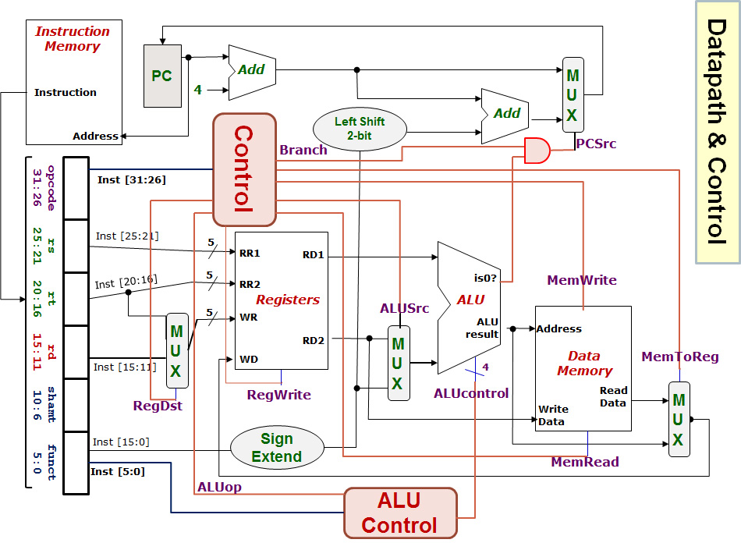
0
1
0
1
0
1
1
0

Slide 35
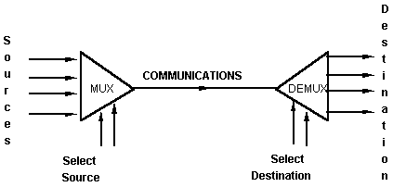
Multiplexers and Demultiplexers
An application:
Helps share a single communication line among a number of devices.
At any time, only one source and one destination can use the communication line.

Slide 36
5. Multiplexers (1/4)
A multiplexer is a device that has
A number of input lines
A number of selection lines
One output line
It steers one of 2^{n} inputs to a single output line, using n selection lines. Also known as a data selector.
2^{n}:1
Multiplexer
inputs
output
:
...
select

Slide 37
5. Multiplexers (2/4)
Truth table for a 4-to-1 multiplexer:
Inputs
Inputs
I₀
0
1
2
3
I₀
I₁
4:1
MUX
I₁
4:1mux
I₂
Y
I₂
Y
Output
I₃
I₃
S₁ S₀
S₁ S₀
select
select

Slide 38
5. Multiplexers (3/4)
Output of multiplexer is
“sum of the (product of data lines and selection lines)”
Example: Output of a 4-to-1 multiplexer is:
Y = ?
I₀∙(S₁'∙S₀') + I₁∙(S₁'∙S₀) + I₂∙(S₁∙S₀') + I₃∙(S₁∙S₀)
Note:
Expressing
I₀∙(S₁'∙S₀') + I₁∙(S₁'∙S₀) + I₂∙(S₁∙S₀') + I₃∙(S₁∙S₀)
in minterms notation, it is equal to
I₀∙m₀ + I₁∙m₁ + I₂∙m₂ + I₃∙m₃
This is useful later (eg: slide 45).

Slide 39
5. Multiplexers (4/4)
A 2^{n}-to-1-line multiplexer, or simply 2^{n}:1 MUX, is made from an n:2^{n} decoder by adding to it 2^{n} input lines, one to each AND gate.
A 4:1 multiplexer circuit:
I₀
I₀
I₁
I₁
Y
Y
I₂
I₂
I₃
I₃
0 1 2 3
2-to-4 Decoder
S₁
S₀
S₁
S₀

Slide 40
5. Multiplexer IC Package
Some IC packages have a few multiplexers in each package (chip). The selection and enable inputs are common to all multiplexers within the package.
A₀
A₁
A₂
A₃
Y₀
Y₁
Y₂
Y₃
B₀
B₁
B₂
B₃
S
(select)
Quadruple 2:1 multiplexer
E'
(enable)

Slide 41
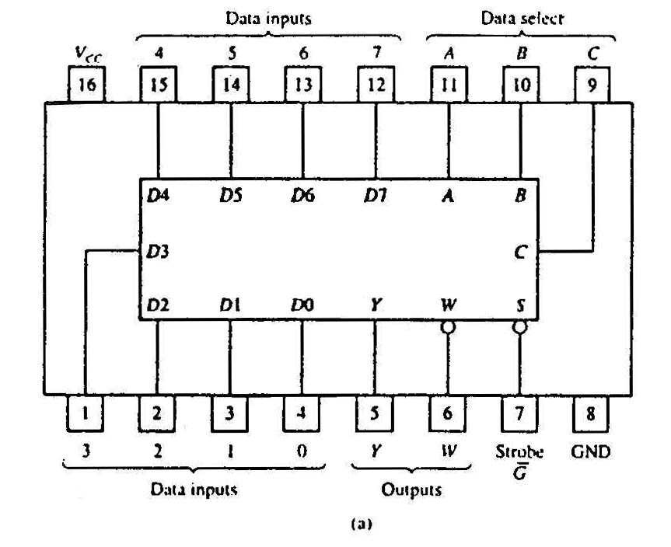
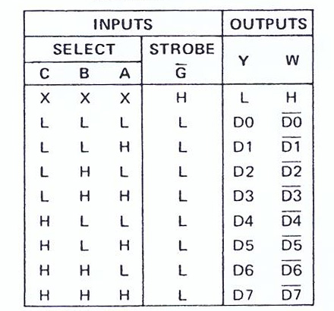
5. Standard MSI Multiplexer (1/2)
(b)
74151A 8-to-1 multiplexer. (a) Package configuration. (b) Function table.

Slide 42
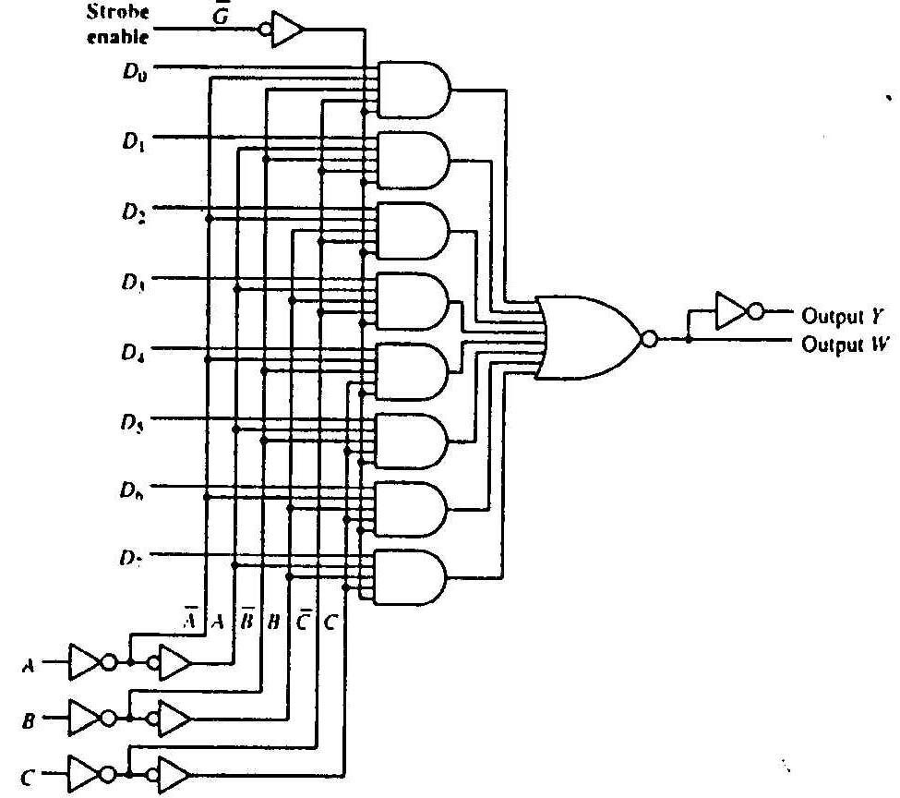
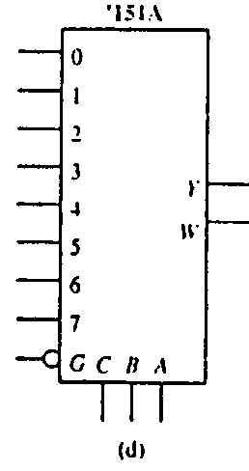
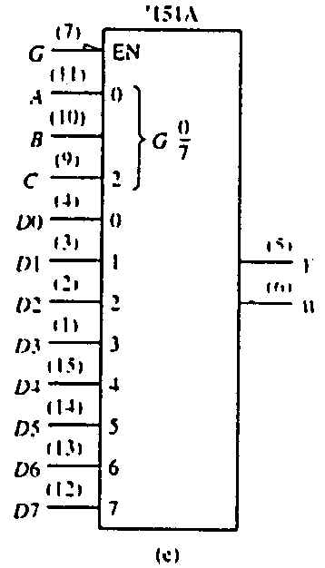
5. Standard MSI Multiplexer (2/2)
(c)
74151A 8-to-1 multiplexer. (c) Logic diagram. (d) Generic logic symbol. (e) IEEE standard logic symbol.
Source: The TTL Data Book Volume 2. Texas Instruments Inc.,1985.

Slide 43
5. Multiplexers: Implementing Functions (1/3)
Boolean functions can be implemented using multiplexers.
A 2^{n}-to-1 multiplexer can implement a Boolean function of n input variables, as follows:
1. Express in sum-of-minterms form.
Example: F(A,B,C) = A'⋅B'⋅C + A'⋅B⋅C + A⋅B'⋅C + A⋅B⋅C' = Σ m(1,3,5,6)
2. Connect n variables to the n selection lines.
3. Put a ‘1’ on a data line if it is a minterm of the function, or ‘0’ otherwise.

Slide 44
5. Multiplexers: Implementing Functions (2/3)
F(A,B,C) = Σ m(1,3,5,6)
This method works because:
Output = I₀⋅m₀ + I₁⋅m₁ + I₂⋅m₂ + I₃⋅m₃ + I₄⋅m₄ + I₅⋅m₅ + I₆⋅m₆ + I₇⋅m₇
Supplying ‘1’ to I₁,I₃,I₅,I₆ , and ‘0’ to the rest:
Output = m₁ + m₃ + m₅ + m₆
0
1
0
1
0
1
1
0
0
1
2
3
4
5
6
7
F
mux
A B C
From slide 34 (4:1 mux)
Expressing
I₀∙(S₁'∙S₀') + I₁∙(S₁'∙S₀) + I₂∙(S₁∙S₀') + I₃∙(S₁∙S₀)
in minterms notation, it is equal to
I₀∙m₀ + I₁∙m₁ + I₂∙m₂ + I₃∙m₃

Slide 45
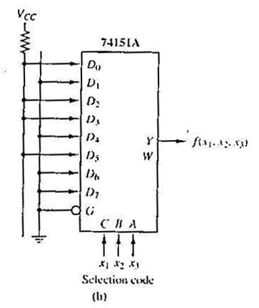
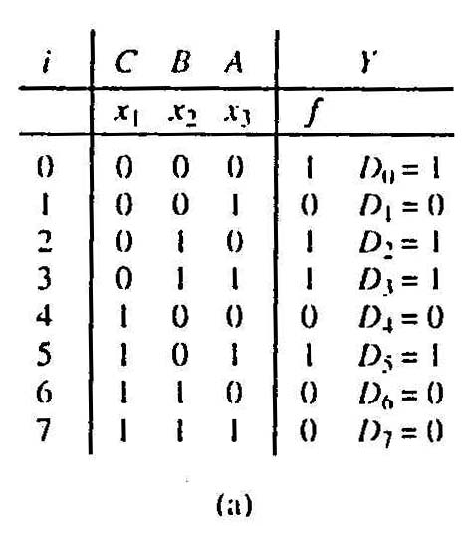
5. Multiplexers: Implementing Functions (3/3)
Example: Use a 74151A to implement f(x₁,x₂,x₃) = Σ m(0,2,3,5)
Realization of f(x₁,x₂,x₃) = ∑m(0,2,3,5).
(a) Truth table.
(b) Implementation with 74151A.

Slide 46
5. Using Smaller Multiplexers (1/6)
Earlier, we saw how a 2^{n}-to-1 multiplexer can be used to implement a Boolean function of n (input) variables.
However, we can use a single smaller 2^{(n-1)}-to-1 multiplexer to implement a Boolean function of n (input) variables.
Example: The function F(A,B,C) = Σ m(1,3,5,6) can be implemented using a 4-to-1 multiplexer (rather than an 8-to-1 multiplexer).

Slide 47
5. Using Smaller Multiplexers (2/6)
Let’s look at this example:
F(A,B,C) = Σ m(0,1,3,6) = A'⋅B'⋅C' + A'⋅B'⋅C + A'⋅B⋅C + A⋅B⋅C'
1
1
0
1
0
0
1
0
0
1
2
3
4
5
6
7
1
C
0
C'
0
1
2
3
F
mux
F
mux
A B C
A B
Note: Two of the variables, A and B, are applied as selection lines of the multiplexer, while the inputs of the multiplexer contain 1, C, 0 and C'.

Slide 48
5. Using Smaller Multiplexers (3/6)
Procedure
1. Express Boolean function in sum-of-minterms form. Example: F(A,B,C) = Σ m(0,1,3,6)
2. Reserve one variable (in our example, we take the least significant one) for input lines of multiplexer, and use the rest for selection lines. Example: C is for input lines; A and B for selection lines.

Slide 49
5. Using Smaller Multiplexers (4/6)
3. Draw the truth table for function, by grouping inputs by selection line values, then determine multiplexer inputs by comparing input line (C) and function (F) for corresponding selection line values.
A | B | C | F | MUX input
0 | 0 | 0 | 1
0 | 0 | 1 | 1
0 | 1 | 0 | 0
0 | 1 | 1 | 1
1 | 0 | 0 | 0
1 | 0 | 1 | 0
1 | 1 | 0 | 1
1 | 1 | 1 | 0
1
C
0
C'
1
0
0
1
2
3
C
F
mux
A B


Slide 50
5. Using Smaller Multiplexers (5/6)
Alternative: What if we use A for input lines, and B, C for selector lines?
A' (when BC = 00)
A' (when BC = 01)
A (when BC = 10)
A
?
?
?
?
0
1
2
3
0
1
2
3
F
A' (when BC = 11)
F
mux
mux
B C
B C


Slide 51
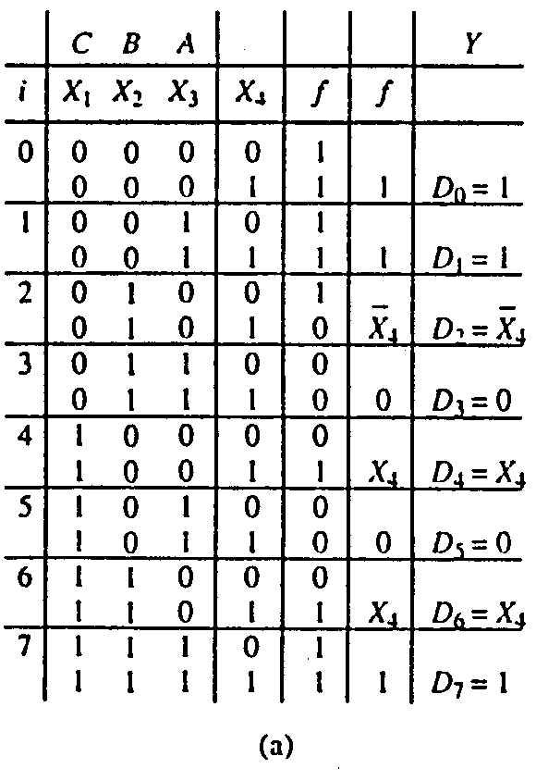
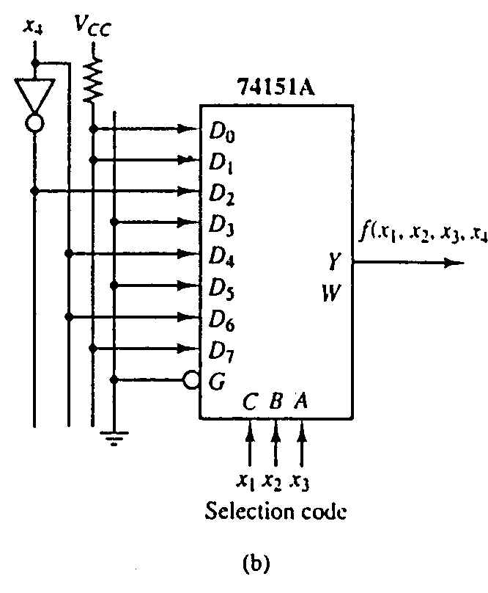
5. Using Smaller Multiplexers (6/6)
Example: Implement the function below with 74151A:
f(x₁,x₂,x₃,x₄) = Σ m(0,1,2,3,4,9,13,14,15)

Slide 52
Peeking Ahead
Address
Input data
Lines
Lines
8 lines
11 10
0 – 9
0–1023
DATA (8)
ADRS (10)
CS
RW
(8)
2x4 decoder
Building a 4K x 8bits RAM using 1K x 8bits RAMs.
1K x 8
S₀
S₁
0
1
2
3
1024 – 2047
DATA (8)
ADRS (10)
CS
RW
(8)
4K locations →12-bit address.
1K x 8
2048 – 3071
Read/write
DATA (8)
ADRS (10)
CS
RW
(8)
Input data
1K x 8
Address
10 lines
8 lines
3072 – 4095
DATA (8)
ADRS (10)
CS
RW
(8)
DATA (8)
ADRS (10)
CS
RW
(8)
Enable
1K x 8
Read/write
1K x 8
Output data
1K x 8bits RAM
Output data
8 lines

Slide 53
QnA Queries (Past Semester’s)

Slide 54
For tutorial 7 q1 why is the 2nd input 0 and E why it cannot be D and E?
4-bit
COMP
0
0
0
1
X₃
X₂
X₁
X₀
Y₃
Y₂
Y₁
Y₀
Full
Adder
2-bit
Adder
X<Y
X=Y
X>Y
V
A
B
C
D
Cin
X
Y
Z
Carry
Sum
Cout
0
X₁
X₀
Y₁
Y₀
S₁
S₀
0
E

Slide 55
Can you go through tutorial 7 q2?
Q2(a)
EFGH = (ABCD+1)/2
A | B | C | D | E | F | G | H
0 | 0 | 0 | 0 | 0 | 0 | 0 | 0
0 | 0 | 0 | 1 | 0 | 0 | 0 | 1
0 | 0 | 1 | 0 | 0 | 0 | 0 | 1
0 | 0 | 1 | 1 | 0 | 0 | 1 | 0
0 | 1 | 0 | 0 | 0 | 0 | 1 | 0
0 | 1 | 0 | 1 | 0 | 0 | 1 | 1
0 | 1 | 1 | 0 | 0 | 0 | 1 | 1
0 | 1 | 1 | 1 | 0 | 1 | 0 | 0
1 | 0 | 0 | 0 | 0 | 1 | 0 | 0
1 | 0 | 0 | 1 | 0 | 1 | 0 | 1
1 | 0 | 1 | 0 | 0 | 1 | 0 | 1
1 | 0 | 1 | 1 | 0 | 1 | 1 | 0
1 | 1 | 0 | 0 | 0 | 1 | 1 | 0
1 | 1 | 0 | 1 | 0 | 1 | 1 | 1
1 | 1 | 1 | 0 | 0 | 1 | 1 | 1
1 | 1 | 1 | 1 | 1 | 0 | 0 | 0
Cin
4-bit
// adder
0
C_{in}
C_{out}
0
A
B
C
X₃
X₂
X₁
X₀
S₃
S₂
S₁
S₀
E
F
G
H
0
0
0
D
Y₃
Y₂
Y₁
Y₀

Slide 56
Can you go through tutorial 7 q2?
Q2(a)
EFGH = (ABCD+1)/2
A | B | C | D | E | F | G | H
0 | 0 | 0 | 0 | 0 | 0 | 0 | 0
0 | 0 | 0 | 1 | 0 | 0 | 0 | 1
0 | 0 | 1 | 0 | 0 | 0 | 0 | 1
0 | 0 | 1 | 1 | 0 | 0 | 1 | 0
0 | 1 | 0 | 0 | 0 | 0 | 1 | 0
0 | 1 | 0 | 1 | 0 | 0 | 1 | 1
0 | 1 | 1 | 0 | 0 | 0 | 1 | 1
0 | 1 | 1 | 1 | 0 | 1 | 0 | 0
1 | 0 | 0 | 0 | 0 | 1 | 0 | 0
1 | 0 | 0 | 1 | 0 | 1 | 0 | 1
1 | 0 | 1 | 0 | 0 | 1 | 0 | 1
1 | 0 | 1 | 1 | 0 | 1 | 1 | 0
1 | 1 | 0 | 0 | 0 | 1 | 1 | 0
1 | 1 | 0 | 1 | 0 | 1 | 1 | 1
1 | 1 | 1 | 0 | 0 | 1 | 1 | 1
1 | 1 | 1 | 1 | 1 | 0 | 0 | 0
Cin
4-bit
// adder
1
C_{in}
C_{out}
E
A
B
C
D
X₃
X₂
X₁
X₀
S₃
S₂
S₁
S₀
F
G
H
0
0
0
0
Y₃
Y₂
Y₁
Y₀

Slide 57
Can you go through tutorial 7 q2?
Q2(b)
4221-to-8421 decimal code converter
P | Q | R | S | W | X | Y | Z
0 | 0 | 0 | 0 | 0 | 0 | 0 | 0
0 | 0 | 0 | 1 | 0 | 0 | 0 | 1
0 | 0 | 1 | 0 | 0 | 0 | 1 | 0
0 | 0 | 1 | 1 | 0 | 0 | 1 | 1
0 | 1 | 1 | 0 | 0 | 1 | 0 | 0
1 | 0 | 0 | 1 | 0 | 1 | 0 | 1
1 | 1 | 0 | 0 | 0 | 1 | 1 | 0
1 | 1 | 0 | 1 | 0 | 1 | 1 | 1
1 | 1 | 1 | 0 | 1 | 0 | 0 | 0
1 | 1 | 1 | 1 | 1 | 0 | 0 | 1
Cin
A1H
0
P
Q
R
A
B
C
D
E
F
G
H
0
W
X
Y
S
Z
57

Slide 58
Past YEARs’ QUESTIONS
MSI Components

Slide 59
Past years’ exam questions
AY2016/17 Sem2 Q2
AY2017/18 Sem2 Q3(a)(b)(c)
AY2018/19 Sem2 Q5(c)
AY2019/20 Sem2 Q5(a)(b)
Assumption
Logical constants 0 and 1 are available, but not complemented literals.

Slide 60
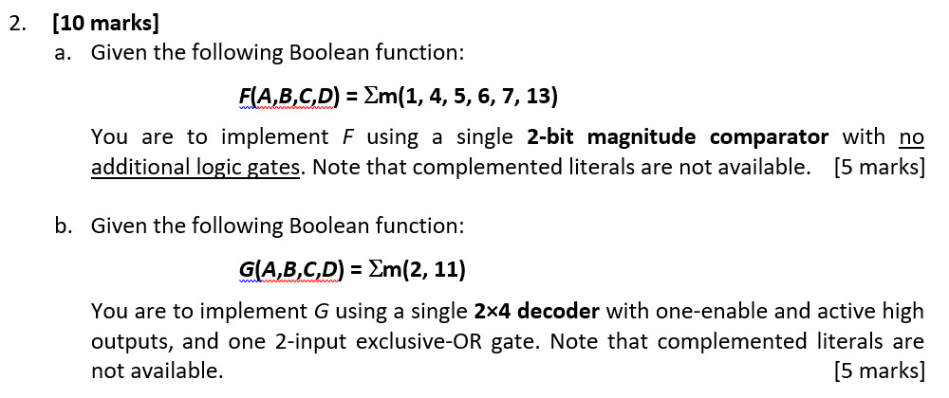
AY2016/17 Sem2 Q2(a)
A | B | C | D | F
0 | 0 | 0 | 0 | 0
0 | 0 | 0 | 1 | 1
0 | 0 | 1 | 0 | 0
0 | 0 | 1 | 1 | 0
0 | 1 | 0 | 0 | 1
0 | 1 | 0 | 1 | 1
0 | 1 | 1 | 0 | 1
0 | 1 | 1 | 1 | 1
1 | 0 | 0 | 0 | 0
1 | 0 | 0 | 1 | 0
1 | 0 | 1 | 0 | 0
1 | 0 | 1 | 1 | 0
1 | 1 | 0 | 0 | 0
1 | 1 | 0 | 1 | 1
1 | 1 | 1 | 0 | 0
1 | 1 | 1 | 1 | 0
2-bit
COMP
Observe that
A
C
1
0
F = AC < BD
X
X<Y
X=Y
X>Y
F
Other answers possible.
B
D
1
0
Y

Slide 61
AY2016/17 Sem2 Q2(b)
2×4
DEC
Observe that
0
1
2
3
G
G(A,B,C,D) = ∑m(2, 11)
= A'⋅B'⋅C⋅D' + A⋅B'⋅C⋅D
= C⋅((A'⋅D' + A⋅D) ⋅B')
= C⋅((A ⊕ D)' ⋅B')
A ⊕ D
B
S₁
S₀
EN
C

Slide 62
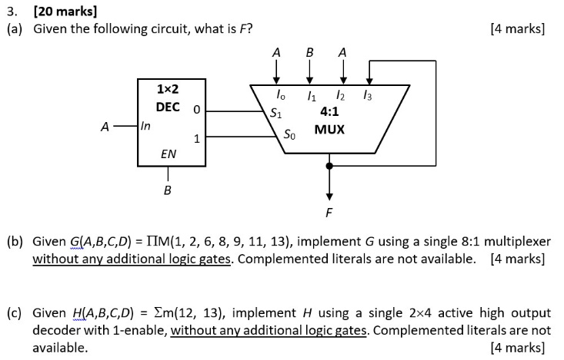
AY2017/18 Sem2 Q3(a)
A | B | F
0 | 0
0 | 1
1 | 0
1 | 1
0
0
1
1
F = A

Slide 63
AY2017/18 Sem2 Q3(b)
A | B | C | D | F
0 | 0 | 0 | 0 | 1
0 | 0 | 0 | 1 | 0
0 | 0 | 1 | 0 | 0
0 | 0 | 1 | 1 | 1
0 | 1 | 0 | 0 | 1
0 | 1 | 0 | 1 | 1
0 | 1 | 1 | 0 | 0
0 | 1 | 1 | 1 | 1
1 | 0 | 0 | 0 | 0
1 | 0 | 0 | 1 | 0
1 | 0 | 1 | 0 | 1
1 | 0 | 1 | 1 | 0
1 | 1 | 0 | 0 | 1
1 | 1 | 0 | 1 | 0
1 | 1 | 1 | 0 | 1
1 | 1 | 1 | 1 | 1
1
B
0
1
B
0
1
B
0
1
2
3
4
5
6
7
8:1
MUX
G
0
1
2
A C D

Slide 64
AY2017/18 Sem2 Q3(c)
H(A,B,C,D) = ∑m(12, 13)
= A⋅B⋅C'⋅D' + A⋅B⋅C'⋅D
= A⋅(B⋅C'⋅D' + B⋅C'⋅D)
= A⋅(B⋅C')
2×4
DEC
0
1
2
3
B
C
S₁
S₀
H
EN
A
Other alternative answers possible.

Slide 65
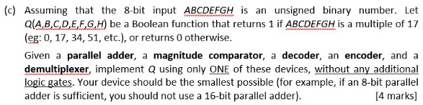
AY2018/19 Sem2 Q5(c)
0₁₀ = 0000 0000₂
17₁₀ = 0001 0001₂
34₁₀ = 0010 0010₂
51₁₀ = 0011 0011₂
68₁₀ = 0100 0100₂
85₁₀ = 0101 0101₂
COMP
:
A
B
C
D
3
2
1
0
X < Y
X = Y
X > Y
255₁₀ = 1111 1111₂
X
Q
E
F
G
H
3
2
1
0
Y

Slide 66
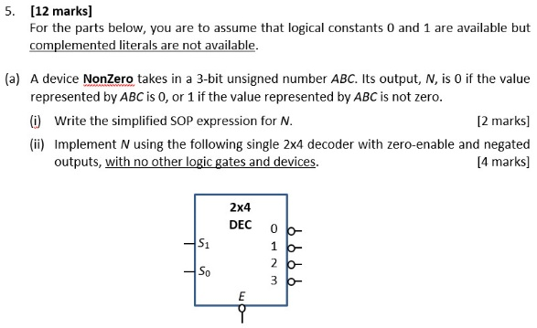
AY2019/20 Sem2 Q5(a)
A | B | C | N
0 | 0 | 0 | 0
0 | 0 | 1 | 1
0 | 1 | 0 | 1
0 | 1 | 1 | 1
1 | 0 | 0 | 1
1 | 0 | 1 | 1
1 | 1 | 0 | 1
1 | 1 | 1 | 1
E + (S1’ ⋅ S0’)’
N
N = A + B + C
A
E + (S1’ ⋅ S0)’
B
E + (S1 ⋅ S0’)’
E + (S1 ⋅ S0)’
C

Slide 67
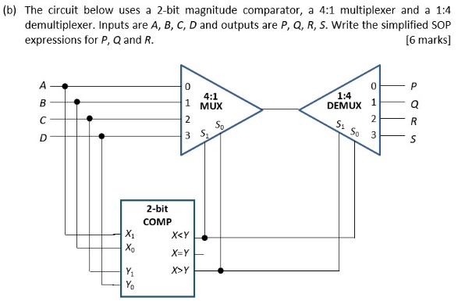
AY2019/20 Sem2 Q5(b)
AB | CD | AB<CD | AB>CD | (MUX) S₁S₀ | (DEMUX) S₁S₀ | PQRS | PQRS
00 | 00 | 0 | 0 | 00 | 00 | A000 | 0000
00 | 01 | 1 | 0 | 10 | 01 | 0C00 | 0000
00 | 10 | 1 | 0 | 10 | 01 | 0C00 | 0100
00 | 11 | 1 | 0 | 10 | 01 | 0C00 | 0100
01 | 00 | 0 | 1 | 01 | 10 | 00B0 | 0010
01 | 01 | 0 | 0 | 00 | 00 | A000 | 0000
01 | 10 | 1 | 0 | 10 | 01 | 0C00 | 0100
01 | 11 | 1 | 0 | 10 | 01 | 0C00 | 0100
10 | 00 | 0 | 1 | 01 | 10 | 00B0 | 0000
10 | 01 | 0 | 1 | 01 | 10 | 00B0 | 0000
10 | 10 | 0 | 0 | 00 | 00 | A000 | 1000
10 | 11 | 1 | 0 | 10 | 01 | 0C00 | 0100
11 | 00 | 0 | 1 | 01 | 10 | 00B0 | 0010
11 | 01 | 0 | 1 | 01 | 10 | 00B0 | 0010
11 | 10 | 0 | 1 | 01 | 10 | 00B0 | 0010
11 | 11 | 0 | 0 | 00 | 00 | A000 | 1000
P = A∙B∙C∙D + A∙B'∙C∙D'
Q = A'∙C + B'∙C∙D
R = B∙C'∙D'+ A∙B∙C'+ A∙B∙D'

Slide 68
quiz
21. MSI Components Quiz

Slide 69
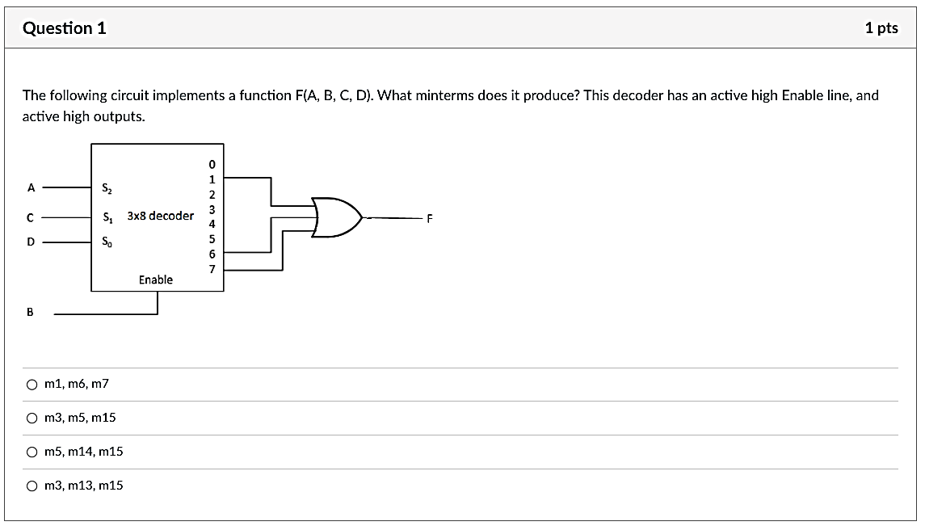
Question 1
A | B | C | D | F
0 | 0 | 0 | 0
0 | 0 | 0 | 1
0 | 0 | 1 | 0
0 | 0 | 1 | 1
0 | 1 | 0 | 0
0 | 1 | 0 | 1
0 | 1 | 1 | 0
0 | 1 | 1 | 1
1 | 0 | 0 | 0
1 | 0 | 0 | 1
1 | 0 | 1 | 0
1 | 0 | 1 | 1
1 | 1 | 0 | 0
1 | 1 | 0 | 1
1 | 1 | 1 | 0
1 | 1 | 1 | 1
0
0
0
0
B.A'.C'.D = m5
0
1
0
B.A.C.D' = m14
0
0
0
0
0
B.A.C.D = m15
0
0
1
1

Slide 70
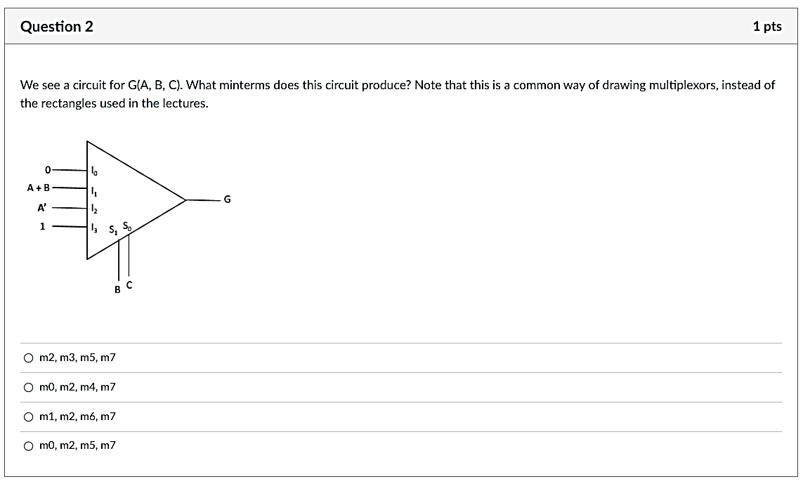
Question 2
BC = 00
A | B | C | G
0 | 0 | 0
0 | 0 | 1
0 | 1 | 0
0 | 1 | 1
1 | 0 | 0
1 | 0 | 1
1 | 1 | 0
1 | 1 | 1
BC = 01
0
BC = 10
0
BC = 11
1
1
0
1
0
1

Slide 71
Next Week This THURSDAY
Sequential Circuits
Online recitation on 27 March 2025, Thursday, 4pm
Zoom link on Canvas > Zoom
Past years’ exam questions:
AY2015/16 Sem1 Q7
AY2020/21 Sem2 Q12

Slide 72
End of File

